Slide 1
Open book exams
Morling COllege

Slide 2
QUESTIONS FROM YOU
Bible and Theology OT
How will the questions be different to previous years' questions given the different nature of the exam?
How should we prepare for the exam?
How much time is recommended in preparing for an exam?
What kind of study notes should I prepare?
PE007 Apologetics
Have been told it is an open book exam.
Wondering how many questions there will be?
Does open book mean you can look up the lecture notes?

Slide 3
Advice from MC Lecturers
In exegetical notes in an examination you should:
* explain the meaning of the passage as a whole
* discuss the relationship between the passage and the book from which it comes, particularly looking at what comes immediately before
* where appropriate, show how any background knowledge (eg. historical information, Old Testament references) helps us to interpret the passage
* where appropriate, discuss any difficulties of interpretation
* explain how significant words and phrases contribute to the effect of the passage
Full sentences should still normally be used, but note form will be permitted if time is running out.
(From David Starling)

Slide 4
CH001 online Details:
The Exam will be administered via Moodle: During exam week, students can access the questions at any time. Dates will be 4-12 June. These dates might be different for other subjects.
Structure of exam
You will need to answer one question from Part A and one question from Part C of the syllabus.
Part A = module 1-4
Part C = modules 10- 14
It is a good idea to study at least 2 topics from Section A and 2 topics from Section C.
(From Nichole Starling)

Slide 5
CH001 online continued
For open-book exams, basic referencing is required: just the author, title, and page number provided in any format. Any verbatim material must be acknowledged with quotation marks and basic referencing.
Make sure you look at the question and address all parts of it explicitly in your answer.
- In this exam, you will be given a primary source extract and you will need to show that you have read the primary source and understood it. Keep coming back to the primary source in your answer.
- include dates and details – show that you understand the historical context.
- scholars – the best answers will also interact critically with the various interpretations that can be found in the secondary literature but most importantly interact with the primary sources
How to Study?
do past papers (they will look different to the one you will do, but they will give you an idea of the kind of questions you might get).
look at primary sources and think about how you would respond to them / incorporate them into your answer.
Read through the background readings and further readings. Work out the main points being made in each article / book chapter and pick out some key quotes relating to the topic.

Slide 6
Open-book exams
One of the biggest myths about open-book exams is that you don't need to study for them. (False)
While these exams don't test your memory, they do
Test your ability to find and use information, solve problems and apply knowledge effectively.
So make sure you are fully familiar with your texts and notes and know where to find necessary information. https://student.unsw.edu.au/preparing-open-book-exams

Slide 7
My normal advice for students writing an exam, modified for an open book exam, is as follows:
1. Read the question, then read it again. Make sure you know what’s being asked of you.
2. Sketch out the framework of your answer to the question, leaving a little space after each heading.
3. Figure out where information to help supplement your answer can be found. Use your knowledge to identify the topic of the question. This should lead you to the relevant section of both the course notes and the textbook(s). [If the student isn’t sure about their ability to identify topics, they should consult the ACT unit description (https://www.actheology.edu.au/our-units/) and look under “content” before their exam. Notes are often structured to follow this content.]
4. Quickly skim this material while keeping the framework from 2. in mind. Note, in the space you left, which parts you will be using to supplement your answer.
5. Write your answer. As a general rule, you should be aiming to make about 10 substantive, independent points in the course of answering your question, not including introduction or conclusion. Make sure to link these points together into a coherent argument.
6. If they have done all of the above they can walk from the exam with confidence.
(From Matthew Andrew)

Slide 8
Preparing for OPEN book exams
Exam Format – type and number of questions, time allowance
Unit Outline – cover all, study notes, fill in blanks
Readings – tag useful sections
Practice questions– old exams, use a timer
Create ‘cheat sheets’ - connect theory /practice, problem/solution

Slide 9



How do you think best?

Slide 10
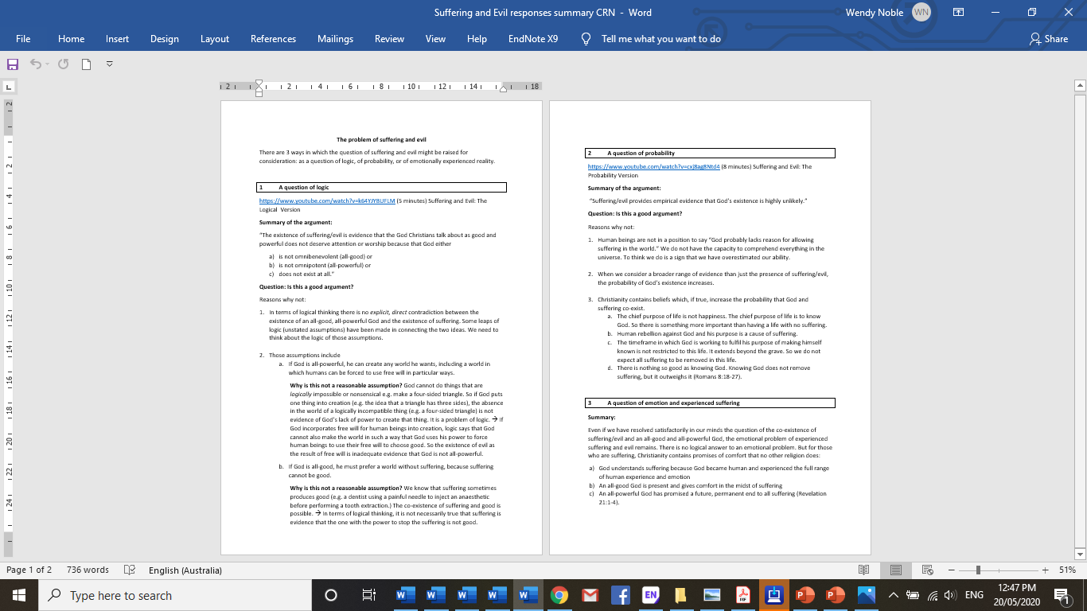
All Business
You think in a linear direction
You like to use headings & boxes
You are neat

Slide 11
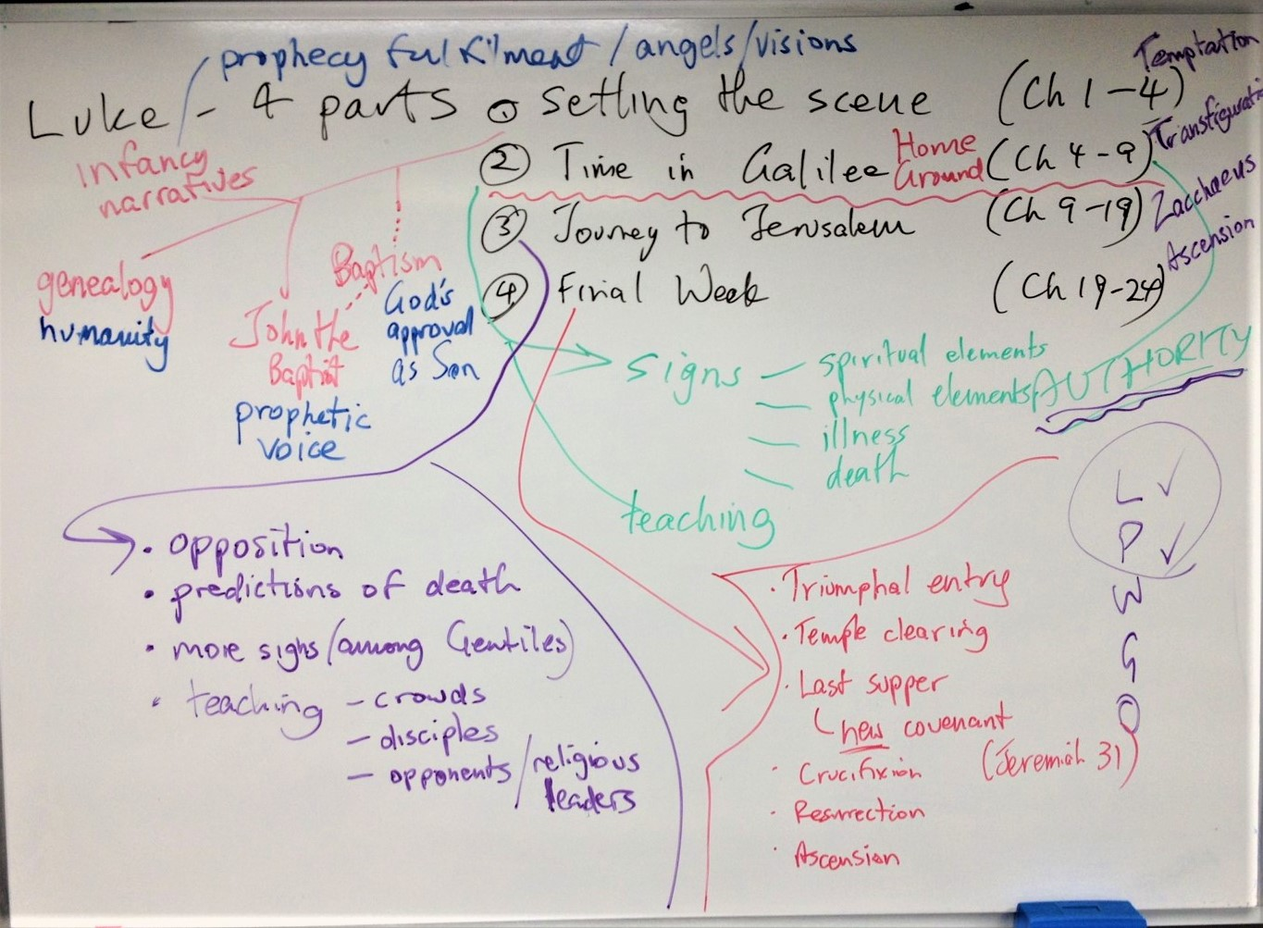
Free thinker
You think in many directions
You like to use colour
You are creative

Slide 12
The pattern of salvation foreshadowed
Enslavement
Israel enslaved in Egypt
Israel in exile in Babylon
Redemption action
the physical Exodus
release from captivity; return and rebuilding of temple and city
Salvation
new life in Canaan (promised land)
sin
Jesus’ death and resurrection
promise of perfect salvation and new exodus through perfect redemption
eternal life
Tech head
You think in flow charts
You like to use shapes
You are visual
see textbook p24-26

Slide 13
Preparing resources uNSW
Before the exam
Use tables of contents and index pages to locate relevant sections in the books you plan to use.
Bookmark useful chapters or pages. Post-it notes can be helpful here.
Prepare brief summaries, e.g. in margins of texts to provide a quick reference.
Prepare a list of key information (formulae, key definitions etc.) likely to be used.
Use index cards to list key topics and relevant page numbers of texts. Use one card per book. This can help you find information quickly.

Slide 14
Preparing notes uNSW
Make some useful notes for yourself
Review the subject to get a good overview
Work out the main themes and topics
Identify key concepts or information
Make brief and legible notes
Summarise important information
Use clear headings
Organise notes by topic
Identify how topics are connected

Slide 15
Writing Exams uNSW
Preparation
Study your course materials
Prepare your study area
Prepare useful notes
Organise your materials
Get a good night's sleep
On the day
Don't panic. Pray!
Eat something
Read all the exam questions carefully
Start with the easy ones
Use quotations sparingly
Don't over answer
Be aware of the time

Slide 16
OT001-5 Task 3 - Exam
Exam is in 2 parts (Pentateuch & Former Prophets).
Part A has 5 questions and Part B has 3 questions.
There is a question from each section of point A of the Learning Outcomes Students must answer 1 question from each part and a third from either part.
Past papers are available on Moodle.
Length: 2 hours plus 10 minutes reading time (COVID19 3 hours –submit by 4)
Learning Outcomes: (See ACT links on the Unit Outline page).
Know and understand: A.1
Be able to: B.1-3

Slide 17
What content do I need to Know?
ACT Unit Outline
OT001-512 - Old Testament Foundations
Learning outcomes
On successful completion of this unit, students will
A. Know and understand
Demonstrate essential knowledge and understanding of the contents, themes and character of the Pentateuch and Historical books
B. Be able to
  1. Outline the content and character of the Pentateuch and Historical books
  2. Describe cultural, historical, religious and literary influences on the Pentateuch and Historical books
  3. Present Organised evidence-based perspectives on the themes and theology of the Pentateuch and Historical books
C. Be in a position to
  1. Relating perspectives from ‘Old Testament Foundations’ to contemporary Christian living and ministry contexts

Slide 18
Old ExaM Papers
OLD TESTAMENT FOUNDATIONS (Online) Semester 1, 2017 OT501
Time allowed: 2 hours (plus 10 minutes reading time) Answer THREE questions. You must answer: ONE question from Section A and ONE question from section B A third question from EITHER Section A OR Section B All questions are of equal value.
SECTION A
1. What does Genesis 1–11 tell us about the nature of sin?
2.Explain how the theme of the promise to Abraham runs through the stories of Isaac (Jacob and Esau) and Jacob (Judah and Joseph).
3.What does the golden calf episode in Exodus 32 reveal about Israel, Moses, and God? How was the relationship between God and Israel restored?
4. What does the book of Numbers teach us about the nature of God, the land, and Israel?
5. What does the book of Deuteronomy teach us about the relationship between grace and law?
SECTION B
6.“Joshua testifies to the faithfulness of God to His promises.” Evaluate this statement with reference to the structure and content of the book of Joshua.
7. What does the narrative concerning the establishment of the Ark of the Covenant in Jerusalem (2 Samuel 5–6) teach about the nature of David’s kingship?
8.Why are the ministries of Elijah and Elisha given such prominence in 1 and 2 Kings? What is the significance of the miracles they performed?
* END OF PAPER *

Slide 19
OLD EXAM PE007 Christian Apologetics
PE620i CHRISTIAN APOLOGETICS EXAM SEMESTER 2/2014
TIME: 2 and 1/2 hours
INSTRUCTIONS: Candidates must attempt three questions, ONE from Section A and ONE from Section B, and the last question may be from either section.
SECTION A
1. You have applied for the position as the evangelical chaplain to Macquarie University. In your application you indicate a commitment to apologetics. In your interview for the position you are asked to define apologetics, to justify it biblically and to explain its relationship to evangelism. A member of the selection committee asks you, “Do you believe the interest some faculty and students have in ‘Postmodernity’ will have a bearing on your apologetic method?” Outline your response to these questions.
2. Discuss the strengths and weaknesses of the apologetic methods of evidentialism, classical apologetics, and pre-suppositionalism.
3. You have been asked to speak at a “seeker service” for Postmodern types who are searching for faith. The title of your address is “Possible Reasons for believing in God”. Your brief is to interact with the classical arguments for the existence of God, although you can certainly explore other arguments such as the place of myth. Outline your address.

Slide 20
SECTION B
5A. In a question and answer session at a church ministry outreach event you are asked by a non-church attender, “Why is there suffering and evil in the world?” Outline your response.
OR
5B. Outline the Humean argument against miracles. How would you counter David Hume’s concerns?
6. You are addressing a group of law students on the resurrection. They refer to Dixon J. of the High Court in the Briginshaw case: “the inherent unlikelihood of an occurrence, or the gravity of the considerations flowing from a particular finding are considerations” that impact the amount of evidence required to establish an incredible event. They insist that more evidence is needed for the resurrection than for an ordinary event. Set out your best case for the resurrection of Jesus, knowing these students are also concerned about the credibility of the Gospels.
7. Describe and evaluate the understanding of religion taken by Ludwig Feuerbach and/or Sigmund Freud. What is your apologetic reply?
https://www.actheology.edu.au/unit/PE007-612/

