Slide 1

Exam Preparation
With Wendy Noble @Morling

Slide 2
Exam Preparation
Ordering your knowledge
Practice exams
Tips for productive study
Tips for writing exams

Slide 3

Ordering Your Knowledge

Slide 4
What do I need to know?
Course content
MC Learning Outcomes
ACT Learning Outcomes
Lecture material
Readings
Old Exam Questions
Exam format
Open or closed book
Time allocation
Number and type of questions
Method of submission

Slide 5
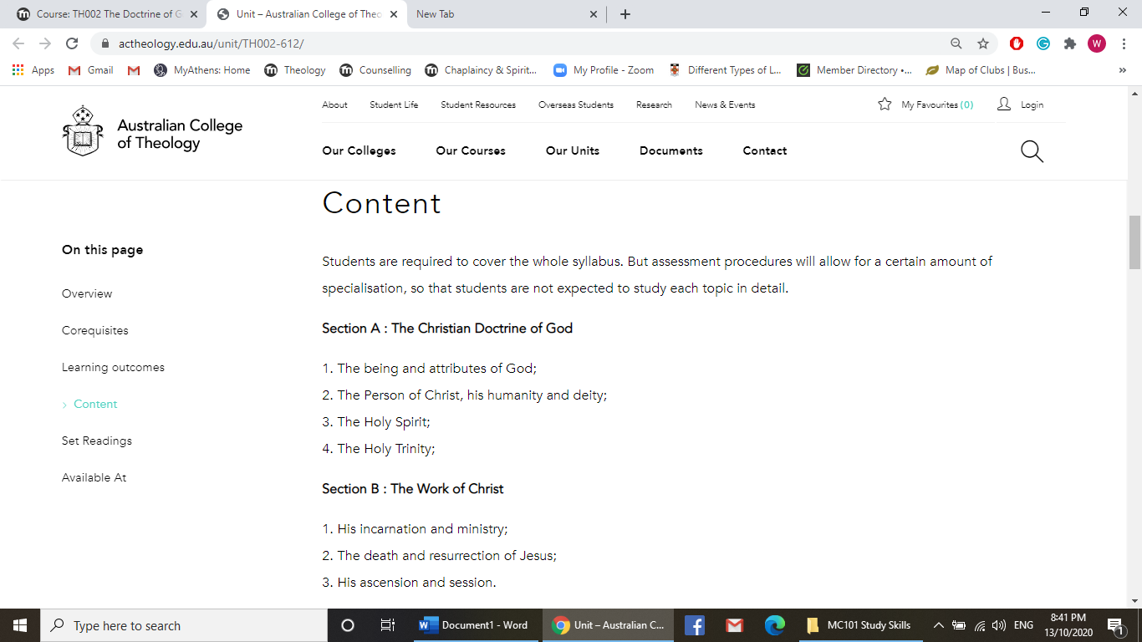
ACT Learning Outcomes for Doctrine of God and Work of Christ

Slide 6
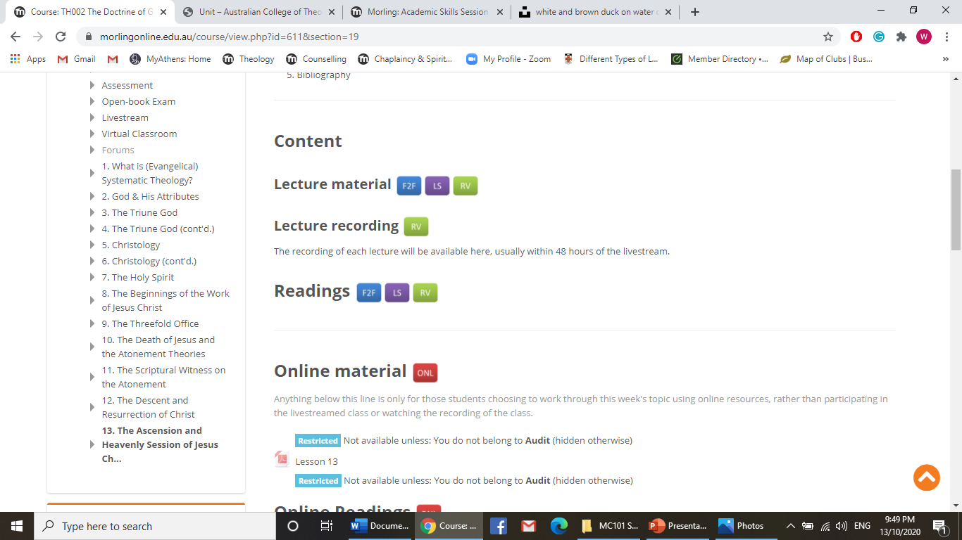
Th002
Doctrine of God and Work of Christ
Main Topics

Slide 7
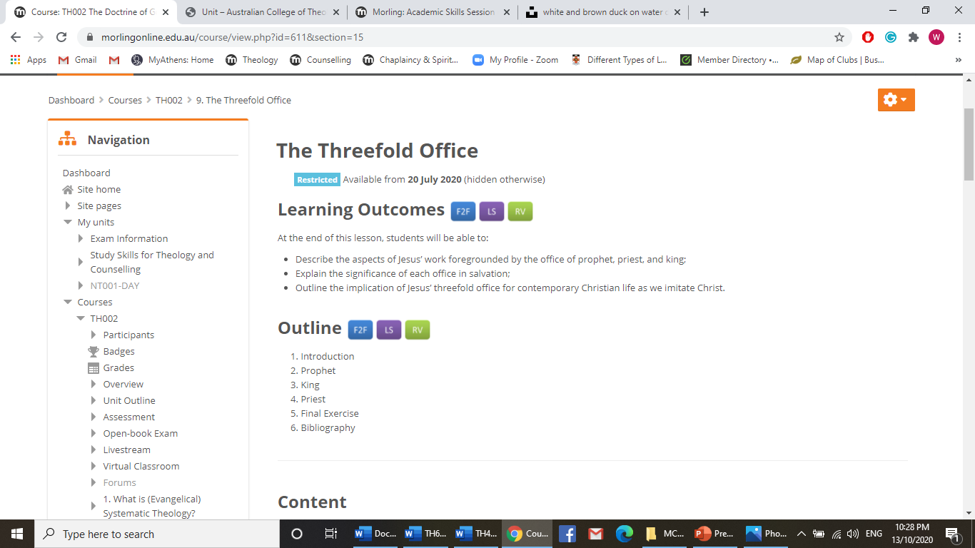
MC Learning Outcomes

Slide 8

Practice Exams

Slide 9
Possible Exam Question
Explain the biblical basis for the “threefold office” of Jesus Christ. Then, using scripture and theologians, explain this statement and discuss its implications to the church’s mission today: “The way in which Christ fulfilled his three office was radically subversive and countercultural.” Reference scripture and theologians (creeds) in your answer.

Slide 10
Possible Exam Question
Explain the biblical basis for the “threefold office” of Jesus Christ. Then, using scripture and theologians, explain this statement and discuss its implications to the church’s mission today: “The way in which Christ fulfilled his three office was radically subversive and countercultural.” Reference scripture and theologians (creeds) in your answer.

Slide 11
Possible Exam Answer Outline Style 1
Intro
Define and show in scripture the threefold office of Jesus Christ as:
Prophet,
Priest
King
In what ways has Christ fulfilled his three offices? (Ways = methods)
Way 1
Way 2
Way n
Where any of these ways ‘radically subversive (against human authority) and counter cultural (against Jewish or other cultural practices)?
Options (choose 1)
Yes (show in scripture and theologians (creeds). OR
No OR
To some extent
Conclusion

Slide 12
Possible Exam Answer Outline Style 2
Intro
Prophet
Define and show in scripture Jesus Christ as prophet:
In what ways has Christ fulfilled his office as prophet?
Where any of these ways ‘radically subversive (against human authority) and counter cultural (against Jewish or other cultural practices)?
Priest
Define and show in scripture Jesus Christ as priest:
In what ways has Christ fulfilled his office as priest?
Where any of these ways ‘radically subversive (against human authority) and counter cultural (against Jewish or other cultural practices)?
King
Define and show in scripture Jesus Christ as king:
In what ways has Christ fulfilled his office as king?
Where any of these ways ‘radically subversive (against human authority) and counter cultural (against Jewish or other cultural practices)?
Conclusion

Slide 13
Table of clue words for exams
Clue word | Meaning
Analyse | To find the main ideas, how they are related and why they are important.
Comment on | To discuss, criticise, or explain its meaning as completely as possible.
Compare | To show both the differences and the similarities.
Contrast | To compare by showing the differences.
Criticise | To give your judgement or reasoned opinion of something, showing its good and bad points. However, it is not necessary to attack.
Define | To give the formal meaning by distinguishing it from related terms.
Describe | To write a detailed account or verbal picture in a logical sequence or story form.
Discuss | To present arguments for and against a point of view and reach a conclusion. The arguments must be supported with appropriate evidence.
Evaluate | To give an opinion, supported by some expert opinions, of the truth or importance of a concept. Show the advantages and disadvantages.
Explain | To make an idea or situation clear to someone by describing it in more detail or revealing relevant facts.
Interpret | To give the meaning using examples and personal comments to make something clear.
Justify | To give a statement of why you think something is so. Give reasons for your statement or conclusion.
Outline | To give a general summary: main ideas supported by secondary facts. Show the organisation of the idea.
Relate | To show the connection between things, telling how one causes or is like another.
Review | To give a survey or summary in which you look at the important parts and criticise if necessary.
Summarise | To give a brief, condensed account of the main ideas.

Slide 14
Advice from lecturers: NT 002 Early NT Church
How should I structure an answer?
- You should aim to write for 40 minutes per question (level 5) or 50 minutes (level 7).
- You should structure it like an essay, with an introduction that sets up the way in which you propose to answer the question, and a brief conclusion that summarises your points (a sentence or two will do).
- The body of your answer should have one point per paragraph. State your point and explain it briefly. Then give some evidence from the text. This might simply be along general lines (e.g. 'Paul defends his character in chapter two'), or it might involve specific verse references. Without going overboard, aim to give a few references to back up each of your points.
- Do not write out bible verses in full, as it just wastes precious writing time! The person marking will have a bible, and will be able to look up the verses you cite.
- Above all, keep in mind the actual question. Don't just look at a question on, say, Colossians, then write everything you know about Colossians in the hope that some of it will be relevant. Higher marks are awarded to students who stay on topic in answering the question, and back up their statements with reference to the biblical text.
- You don't need to be able to quote scholars, footnote, etc.

Slide 15
Old Exam Question: NT002
James
What are the main errors that James is writing to correct?
In what ways is James’ audience tempted to be ‘double-minded’? How does James urge them to respond to this temptation?
How does the letter of James reflect the teachings of Jesus?
‘Who is wise and understanding among you? Let them show it by their good life’ (James 3:13). How does James go about teaching his readers about what is ‘wise’ and what constitutes a ‘good life’?

Slide 16
Old Exam Question: NT002
James
What are the main errors that James is writing to correct?
In what ways is James’ audience tempted to be ‘double-minded’? How does James urge them to respond to this temptation?
How does the letter of James reflect the teachings of Jesus?
‘Who is wise and understanding among you? Let them show it by their good life’ (James 3:13). How does James go about teaching his readers about what is ‘wise’ and what constitutes a ‘good life’?

Slide 17
Possible Exam Answer Outline
Intro
main errors
First error
Second error
Etc.
James’ audience was tempted to be ‘double-minded.’ James urged them to respond to this temptation
Way 1 + James taught response A
Way 2 + James taught response B
The letter of James reflects the teachings of Jesus in 2, or 3 or 4 ways
‘Who is wise and understanding among you? Let them show it by their good life’ (James 3:13). James taught his readers about what is ‘wise’ and what constitutes a ‘good life by x, y and z.

Slide 18

Tips for preparing
Pay attention to your lecturers’ advice
Gather content to address learning objectives
Fill in the blanks with research
Seek out practice exam questions
Get used to writing under time constraints
Define key terms
Be familiar with relevant scripture (chapter if not verse!)
Select a few quality sources
Breathe

Slide 19
Tips for writing exams
Have a good night’s sleep
Pray – remember you are loved!
Read the whole paper
Select easier Qs first
Jot a quick outline
Manage your time
Write a simple intro
One idea per paragraph
Topic sentence + examples. Evidence
Move on to next question
Allow time to re-read. Does it make sense?

Slide 20
References
‘Clue Words’ https://student.unsw.edu.au/clue-words
Unsplash credits: William Felker, Birger Strahl, Alexandr Podvalny, Nick Fewings

